Slide 1
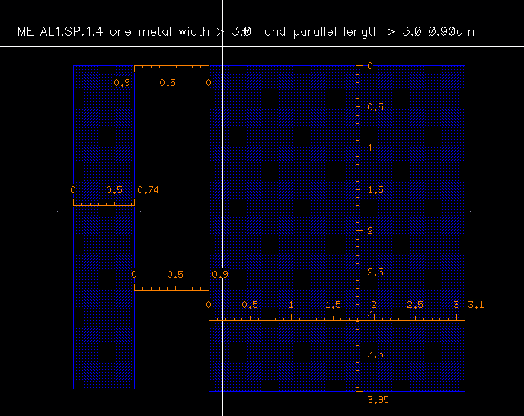
METAL1.SP.1.4
> 0.3um
> 0.90um
> 0.3um
ILD
STI
P-substrate

Slide 2
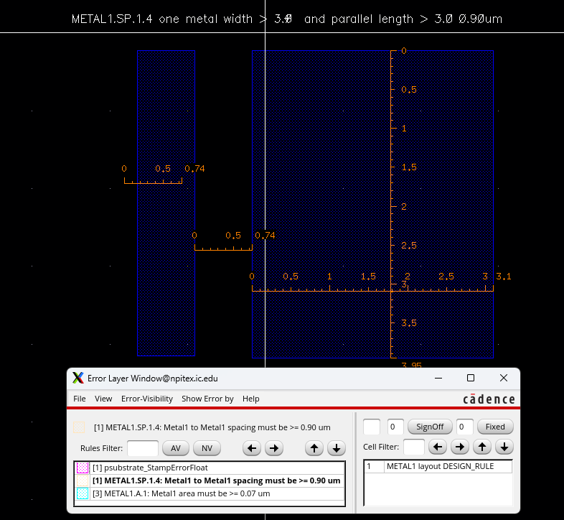
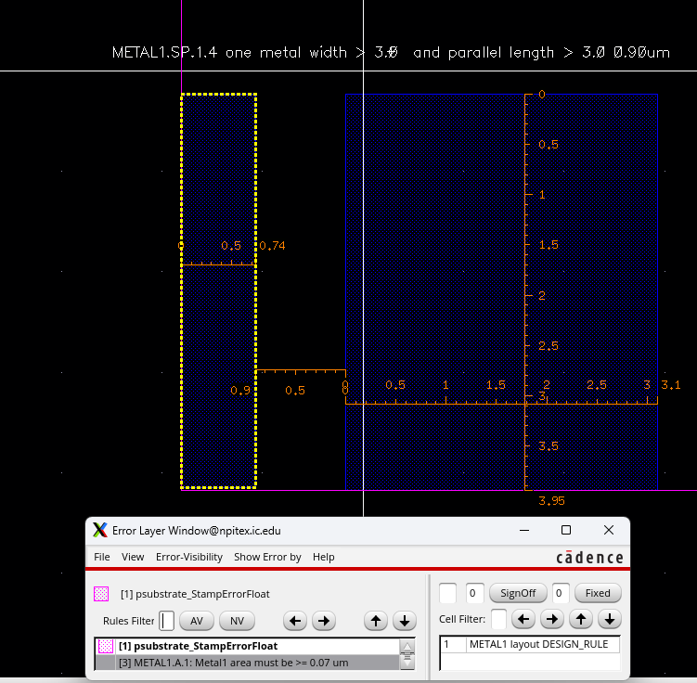
DRC
DRC error (space = 0.74um)

